Slide 1
Multi-Aspect Query Summarization by Composite Query
Date: 2013/03/11
Author: Wei Song, Qing Yu, Zhiheng Xu, Ting Liu, Sheng Li, Ji-Rong Wen
Source: SIGIR "12
Advisor: Jia-ling, Koh
Speaker: Jiun Jia, Chiou

Slide 2
Outline
Introduction
Query Aspect
Query Summarization in Multi-Aspects
Information Gathering
Summary Generation
Experiment
Conclusion

Slide 3
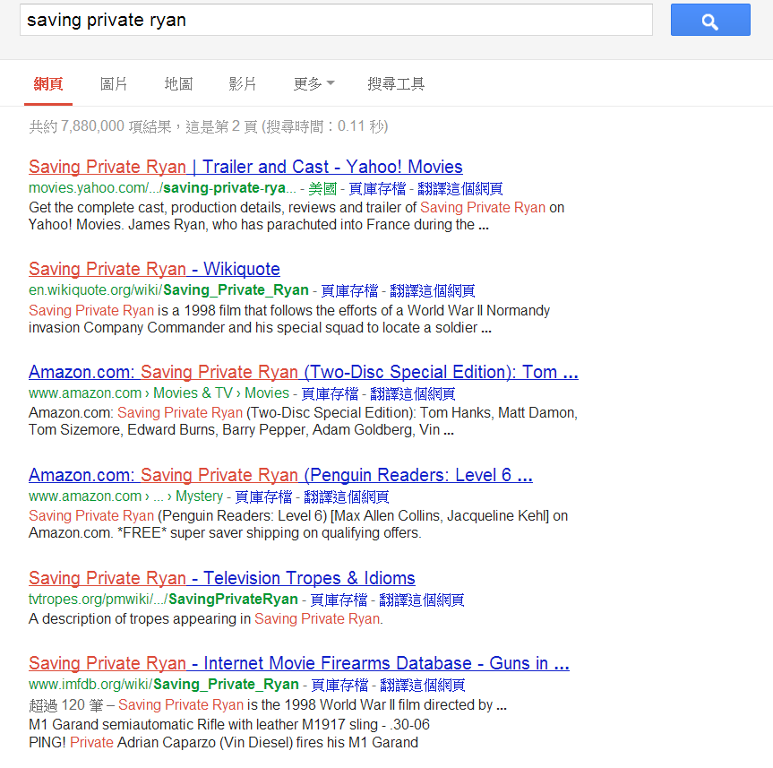
Introduction
Current web search engines usually provide a ranked list of URLs to answer a query.
It’s becoming increasingly insufficient for queries with vague or complex information need.
Users have to visit many pages and try to
find relevant parts within long pages.
The information may be scattered across
documents.

Slide 4
Introduction
The search result of the original query may not contain enough information for all aspects that users care about, because the search engine returns documents only considering whether a document is relevant to the query keywords.
Users may want to know about a topic from multiple aspects.
Understanding user intents.
(2) Providing relevant information directly to satisfy searchers’ needs,
as opposed to relevant pages.
Organizing the web content relevant to a query according to user intents would benefit user exploration.

Slide 5
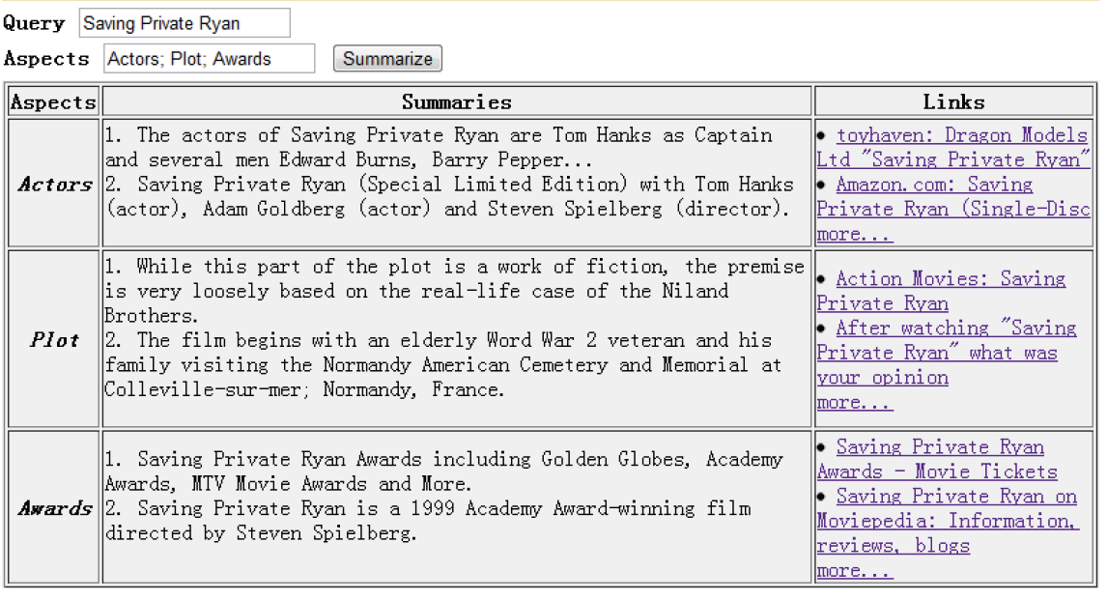
For better aspect oriented exploration, the information for different query aspects should be as orthogonal as possible.
Notes:
First, the search result of the original query may not contain enough information for all aspects that users care about, because the search engine returns documents only considering whether a document is relevant to the query keywords, rather than its aspects.
Second, for better aspect oriented exploration, the information for different query aspects should be as orthogonal as possible. It is important to distinguish the aspect specific information from the general information about the whole query. By using the composite queries, we could get more specific information for each aspect.

Slide 6
Introduction
Multi-aspect oriented query summarization:
Provide specific and informative content to users directly and helps for further exploration.
Given
1. Query
2. Set of aspects
Generate a summary for each
query aspect.
Information Gathering
Summary Generation
Leverages the search engine to proactively gather related information.
Using the search result of the original and composite query to collect query aspect related information.
Notes:
1.Using the search result of the original query, we also composite a set of new queries and submit them to the search engine to collect query aspect related information.

Slide 7
Outline
Introduction
Query Aspect
Query Summarization in Multi-Aspects
Information Gathering
Summary Generation
Experiment
Conclusion

Slide 8
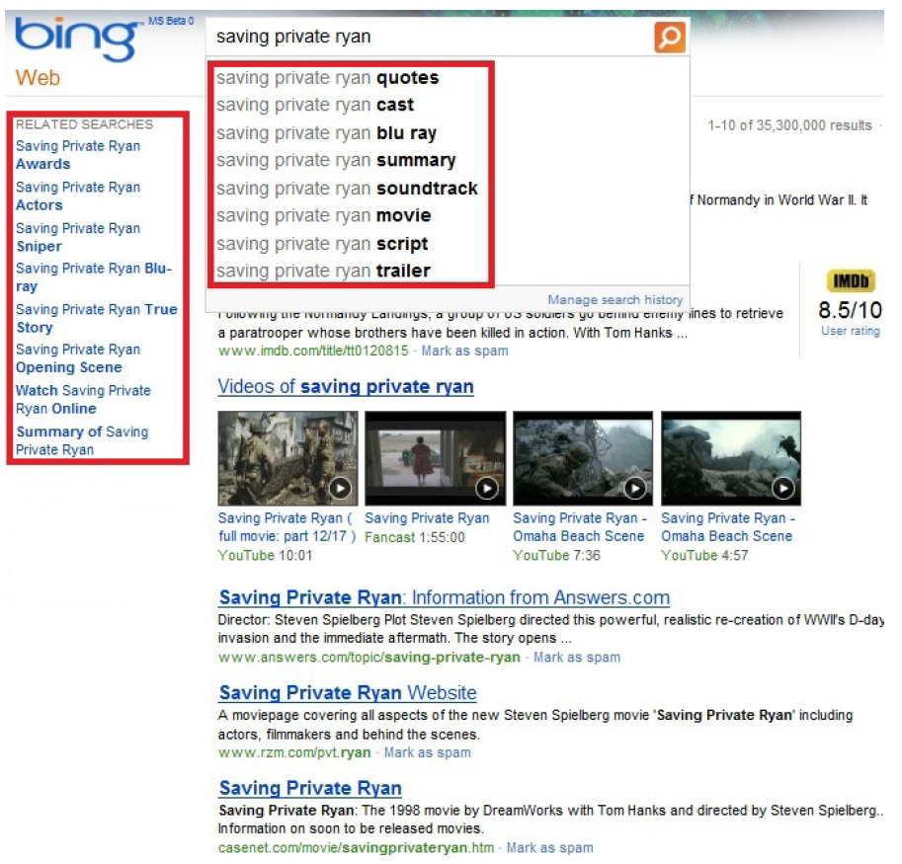
Query Aspect
Define an aspect as a query qualifier - keywords that are added to an original query to form a specific user intent.
reviews
movie
actors
Use search engines provide:
query suggestion
related searches

Slide 9
Outline
Introduction
Query Aspect
Query Summarization in Multi-Aspects
Information Gathering
Summary Generation
Experiment
Conclusion

Slide 10
Author expect to generate both specific and informative summary for each aspect instead of a set of documents so that the users could get relevant information directly.
Actor ??
Query:
Saving Private Ryan
A movie page covers information about new Steven Spielberg movie 'Saving Private Ryan' including actors, film makers and behind the scenes.
Saving Private Ryan cast are listed here including the Saving Private Ryan actresses and actors featured in the film.
(iii) The actors of Saving Private Ryan are Tom Hanks as Captain and several
men Edward Burns, Barry Pepper...
General information-Not specific to the desired aspect.
It doesn’t provide relevant information directly.
It is both specific and informative-provides direct answers
to the desired aspect. (the names of the actors)

Slide 11
Information Gathering
Collect more aspect related data which may be not contained in original query’s search result.
Original query ( Q ) | Saving Private Ryan
Aspect ( A_{k} ) | actors
Composite query ( Q+A_{k} ) | Saving Private Ryan actors
The search result of Q (C_{Q}) provides
overall information about the query
Search result of Q + A_{k} ( C_{Q+Ak} ) provides the information about the aspect A_{k} of the query Q.
The search result of A_{k} ( C_{Ak}) provides information about the aspect itself which is query independent
Notes:
There may be not enough information for certain query aspects, if we only use the search result of the original query.
For example, some users wonder whether movie “Saving Private Ryan” tells a true story, but few top documents in the search result of “Saving Private Ryan” discuss this topic.

Slide 12
Outline
Introduction
Query Aspect
Query Summarization in Multi-Aspects
Information Gathering
Summary Generation
Experiment
Conclusion

Slide 13
Summary Generation
The words in search results could be divided into 3 categories:
Query Common Words
Query Aspect Words
Global Background Words
Occur frequently across multiple aspects
“movie”, “TV”, “IMDB”
for “Saving Private Ryan”
Provide information for an aspect
“cast”, “list” and “Tom Hanks” for the aspect “actors”
Distribute heavily on the
Web
Stop words
Building Model
θ_{B}
θ_{k}
θ_{G}

Slide 14
Summary Generation
The generative process could be seen as 2 steps:
Decide whether this word is from θ_{G}
Then decide it comes from θ_{B} or θ_{k}.
maximizing the log-likelihood of the collection C_{Q+Ak}
Global Background Words
Query Common Words
Query Aspect Words

Slide 15
d
Document 1 (d1) | Document 2 (d2) | Document 3 (d3) | Document 4 (d4) | Document 5 (d5)
1 | 0 | 1 | 1 | 0
0 | 1 | 1 | 1 | 1
1 | 0 | 1 | 0 | 1
t
Term 1 (t₁)
Term 2 (t₂)
Term 3 (t₃)
p₁ =$\frac{1+0+1}{10}$ = 0.2
P(d1,d2,d3,d4,d5,….)=$\prod_{i}{\text{p}\text{i}\text{d}\text{i}}$
L(p₁,p₂,p₃,p₄,p₅|D) = log ∏_{t} ∏_{i} p_{i}^{dit}
Training !!
p₂ =$\frac{0+1+0}{10}$ = 0.1
where d_{i}^{t} = 1 if term t in d_{i}
d_{i}^{t} = 0 otherwise
p₃ =$\frac{1+1+1}{10}$ = 0.3
p₄ =$\frac{1+1+0}{10}$ = 0.2
Maximum Likelihood Estimation : p_{i} = (∑_{t} d_{i}^{t} ) / N
p₅ =$\frac{0+1+1}{10}$ = 0.2
P(w|θ_{G}) = 0.2^{d1} * 0.1^{d2} * 0.3^{d3} * 0.2^{d4} * 0.2^{d5}

Slide 16
Saving Private Ryan actor
Saving Private Ryan
W₁ : 1 W₂ : 0 W₃ : 1
W₁ : 3 W₂ : 2 W₃ : 2
Search result
Search result
Saving Private Ryan film
W₁ : 0 W₂ : 0 W₃ : 1
p(W₁ |θ_{B}) =$\frac{3+(1+0)}{\left(3+1\right)+\left(2+0\right)+(2+2)}$ = 0.4
Search result
p(W₂ |θ_{B}) =$\frac{2+(0+0)}{\left(3+1\right)+\left(2+0\right)+(2+1)}$ = 0.2
p(W₃ |θ_{B}) =$\frac{2+(1+1)}{\left(3+1\right)+\left(2+0\right)+(2+1)}$ = 0.4

Slide 17
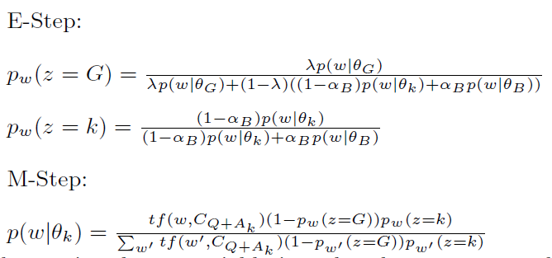
Expectation Maximization(EM) Algorithm
Find Optimal Parameter
Training Query
Aspect Words
Model( Θ_{k} )
Distinguish the query aspect words from the query common words.
The words with high probabilities in θ_{k} represent the specific query aspect better.
Notes:
In this way, we distinguish the query aspect words from the query common words. The words with high probabilities in Θ_{k} represent the specific query aspect better.

Slide 18
Summary Generation
Modeling
Search Result
Sentence
Selection

Slide 19
Summary Generation
Sentence Selection
Candidate Sentences Ranking:
specificity
redundancy
informativeness
The top ranked sentences are used as a summary for the desired aspect.
Specificity:
p(t1|θ_{B}) * p(t2|θ_{B}) * P(t3|θ_{B}) * …..
p(t1|θ_{k}) * p(t2|θ_{k}) * P(t3|θ_{k}) * …..
p(t1|θ_{G}) * p(t2|θ_{G}) * P(t3|θ_{G}) * …..
The actors of ″ Saving Private Ryan″ include Tom Hank, Edward Burns.
1 2 3 4 5 6 .....
The selected candidate sentences are more specific to the desired aspect.

Slide 20
Redundancy:
1. Each single sentence is initiated as a cluster.
2. If two clusters are close enough, they are merged.
3. This procedure repeats until the smallest distance between all remaining
clusters is larger than a threshold. (0.7)
Edit distance
S1 S3
String 1: "kitten“ String 2: "sitting"
S4 S6
Step 1 | kitten → sitten (substitution of 's' for 'k')
Step 2 | sitten → sittin (substitution of 'i' for 'e')
Step 3 | sittin → sitting (insertion of 'g' at the end)
S2
S5
S7
Edit distance between “kitten“ and ”sitting” : 3
U(S1).size = 4
U(S7).size = 3
Similarity: 1/distance =0.33

Slide 21
Informativeness:
β set: 0
QDW: query dependent aspect words :
EX: “Tom Hanks” and “Edward Burns” for aspect “actors”.
“actor”, “actress”, and “cast” for aspect “actors”.
{term|term ∈ C_{Q+Ak} and term ∉ C_{Ak}}
✔
✘
Candidate Sentence Ranking

Slide 22
Outline
Introduction
Query Aspect
Query Summarization in Multi-Aspects
Information Gathering
Summary Generation
Experiment
Conclusion

Slide 23
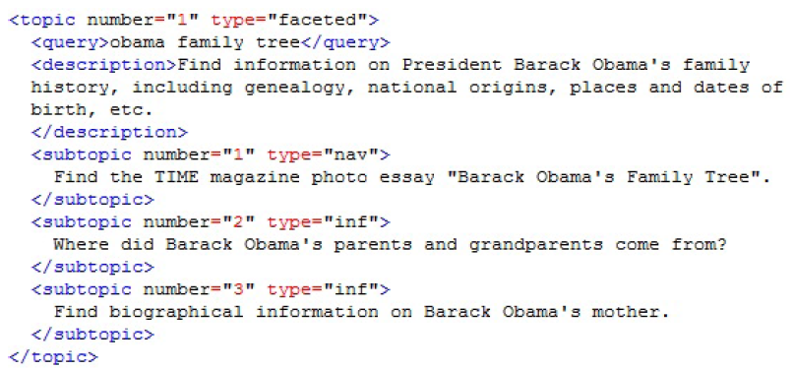
Experiment
Data Sets:
Wikipedia (January 2011)
Ex: ″Saving Private Ryan ″ ″Plot″, ″Cast″, ″Product″
Sample: 1,000 pages(queries)
TREC
title | list of sub section(subheadings)
[query] | [query aspect]
50 topics
Each topic has 3 to 8 subtopics
Notes:
Wiki data : Filtered out the meaningless subheadings like “Notes”, “References” and “Further Readings” by rules.

Slide 24
Experiment
Compare: evaluate the multi-aspect oriented query summarization.
Proposed method – Q-Composite
Baseline 1 – Ling-2008
Baseline 2 – Snippet
Evaluation on Wikipedia Data
Send both the original query and the composite queries to search engine and get the search result documents and snippets.
Using ROUGE-1 tool for evaluation on Wikipedia data
Higher value → highly consistent with human judgements
Evaluation on TREC 2009 Data
Need index summaries from TREC and build a small search engine.
Judge the quality of generated sentences manually
Specific
Informative
Notes:
The second baseline is based on the top sentences in snippets, which are provided by a search engine for each composite query Q+A_{k}, denoted as Snippet. The number of the top sentences depends on the total summarization length limit.

Slide 25
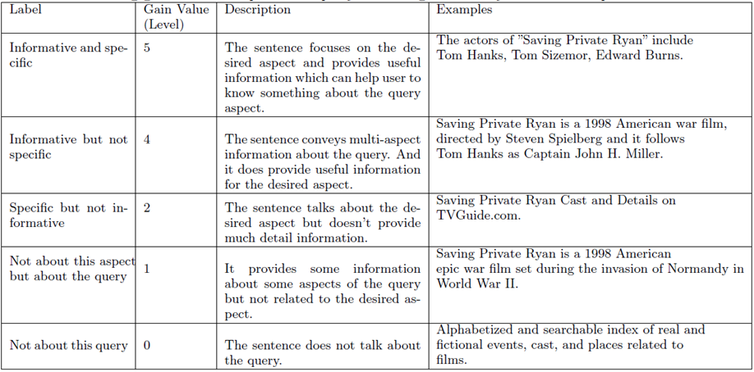
Asking labelers to label the generated sentences for 50 queries. For each system and each query aspect, the labelers had to evaluate the top 3 ranked sentences.
The normalized Discounted Cumulative Gain (nDCG) is used to evaluate the performance.

Slide 26
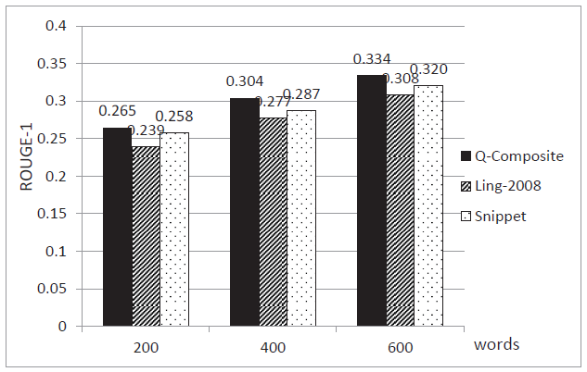
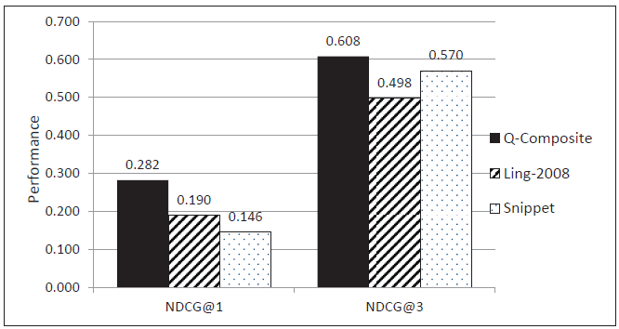
Experiment
Wikipedia
word number of summary length limit
TREC 2009

Slide 27
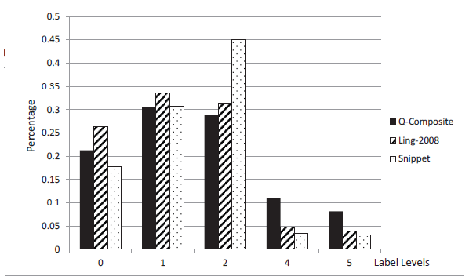
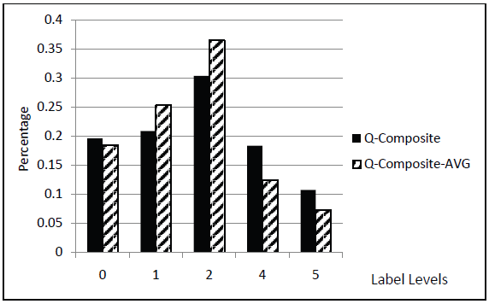
Q-Composite : β = 0
Q-Composite-AVG : β = 0.5
Generate Top 1 Sentence !!
TREC 2009

Slide 28
Outline
Introduction
Query Aspect
Query Summarization in Multi-Aspects
Information Gathering
Summary Generation
Experiment
Conclusion
28

Slide 29
Conclusion
Multi-aspect oriented query summarization task aims to summarize a query from multiple aspects which are aligned to user intents.
Information gathering phase : proposed a composite query based strategy, which proactively gets information based on the search engine.
Summary generation phase : took into consideration the specificity, informativeness and redundancy for sentence selection.
The proposed method attempts to directly provide well organized and relevant information to users, as opposed to relevant documents.
29

